Slide 1
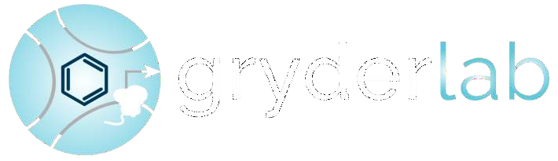

Epigenetics and 3D chromatin
Berkley E. Gryder, Ph.D.
Assistant Professor, Case Western Reserve University, School of Medicine
Member, Angie Fowler AYA and Case Comprehensive Cancer Center

Slide 2
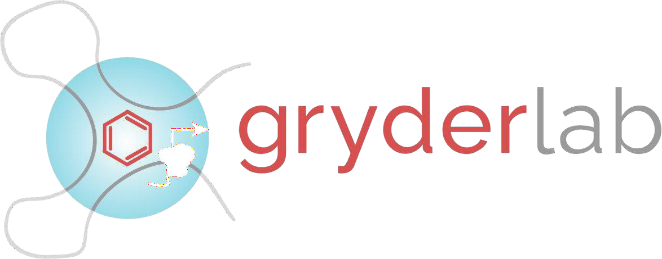
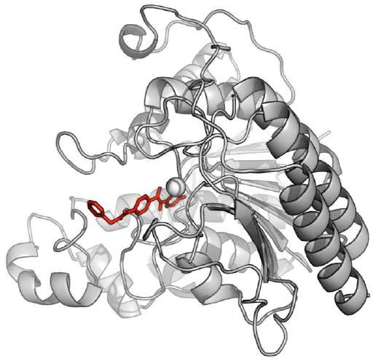
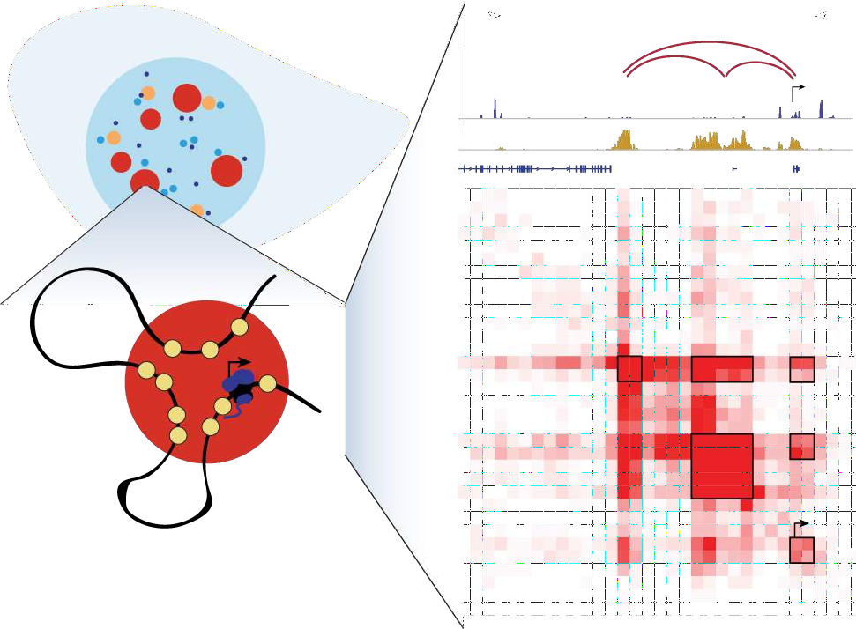
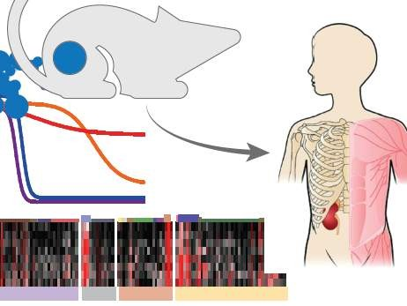
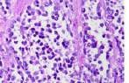
Cancer Biology and Therapy Childhood Sarcomas, Prostate Cancer, many others
Chemical Biology Transcription Factors and Epigenetic Regulators
3D Systems Biology Transcriptional Condensates

Slide 3
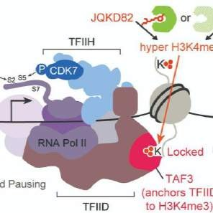
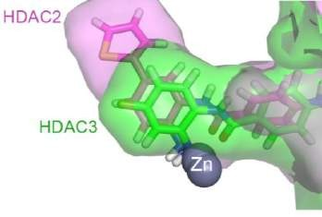
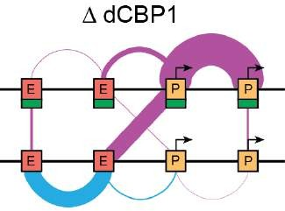
HDACs
& H3K27ac
KDM5A
& H3K4me3
HATs
& RNA Pol 2
New mechanism to explain HDAC inhibition
New mechanism to explain KDM5A inhibition
Pol2 cluster collapse
Nature Comm., 2019
Nature Genetics, 2019
Blood Cancer
Discovery, 2021
Unpublished

Slide 4
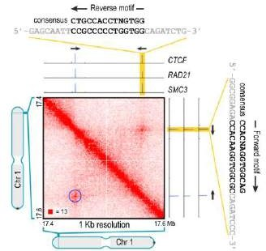
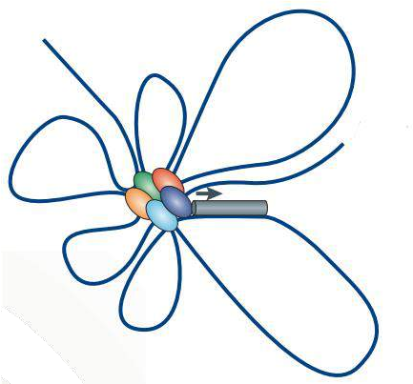
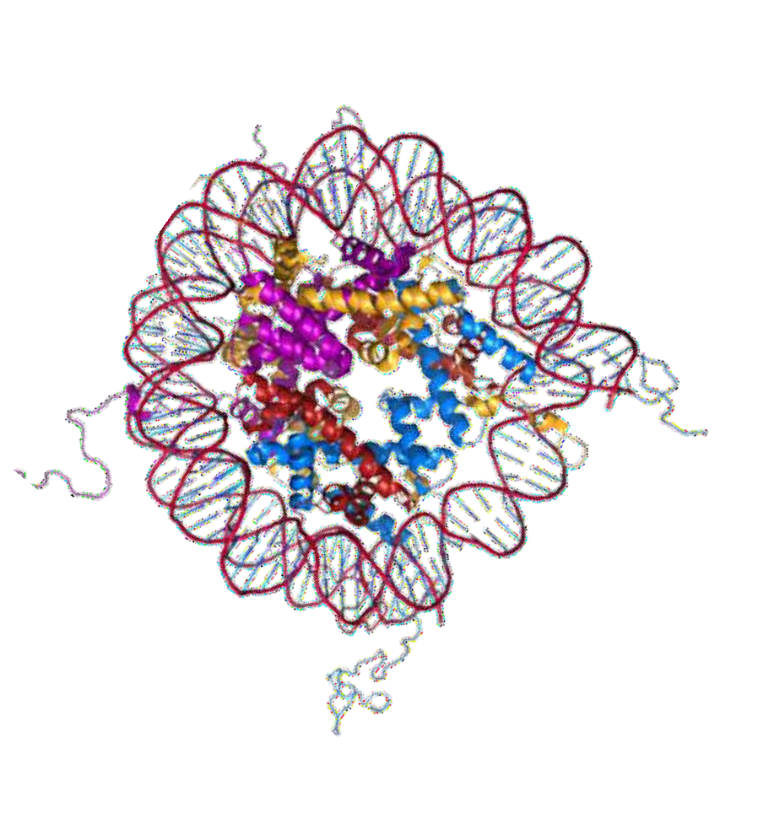
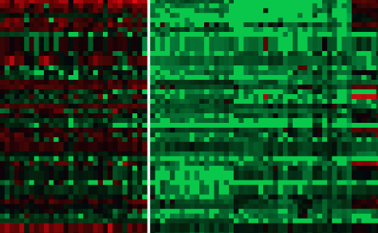




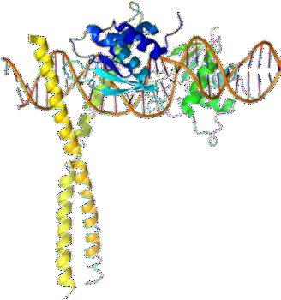
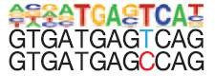
Non-Protein-Coding DNA Drives Epigenetics
Origami
Code
3D Enhancer-
Gene pairing
Epigenetic Codes
Gene expression
TF
binding
Enhancer Code
Cell identity and function

Slide 5
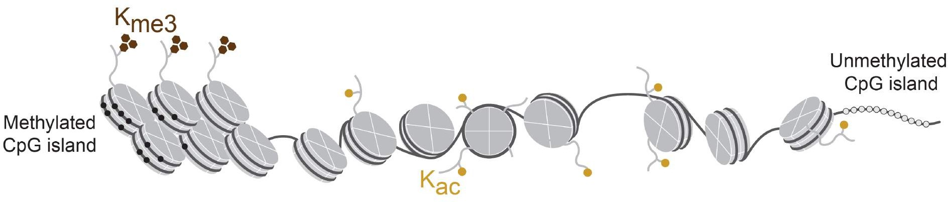
2 Epigenetic “Codes”
The histone modification code
DNA methylation code

Slide 6
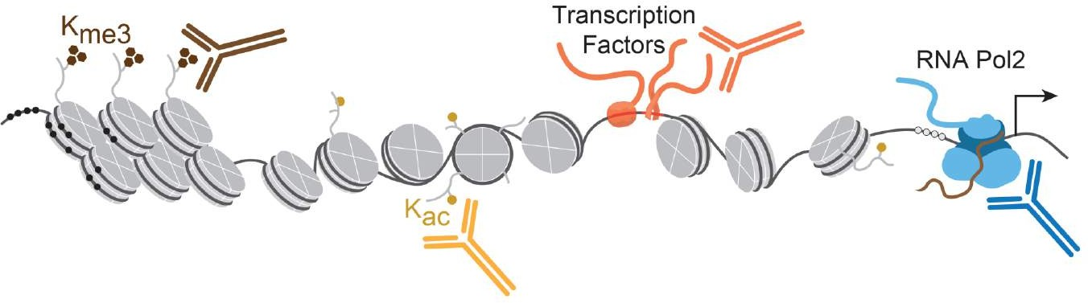
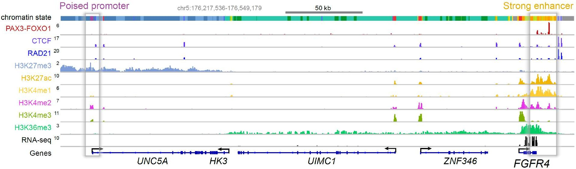
Chromatin Immunoprecipitation (ChIP)
ChIP-sequencing

Slide 7
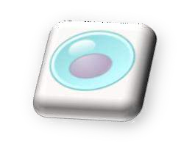
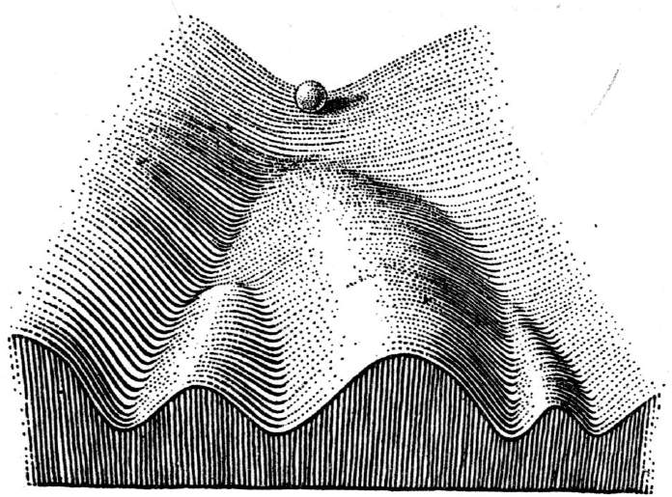


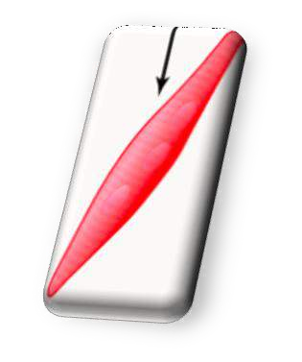

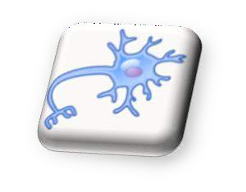
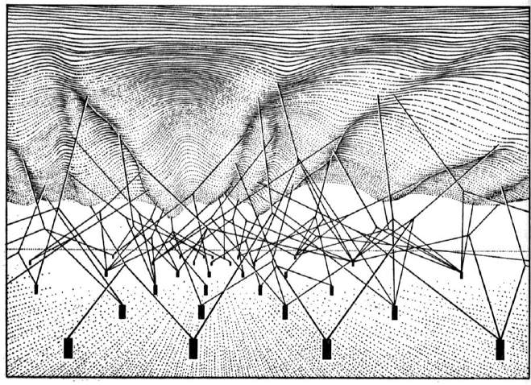
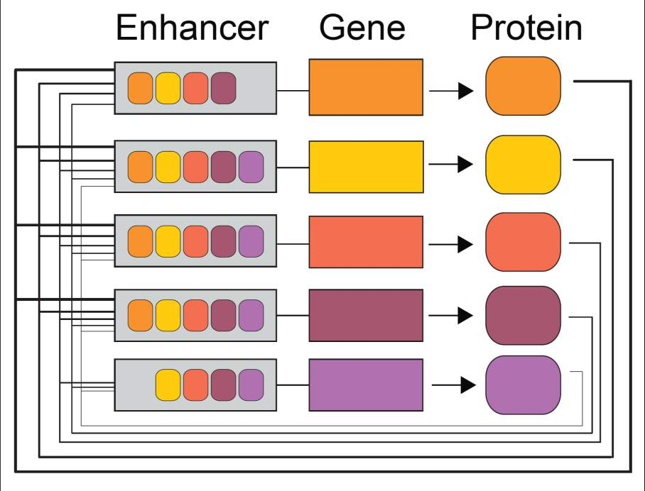
“to account for the fact that development is channeled into separate, distinct pathways: if the product of the reaction makes the reaction go faster… autocatalytic… self regulating…
In cell differentiation we must be dealing with
chemical cybernetic systems”
1953, Conrad Waddington
Core Regulatory Transcription Factors
=
1957, Conrad Waddington
7

Slide 8


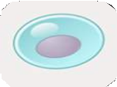

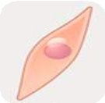

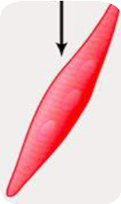

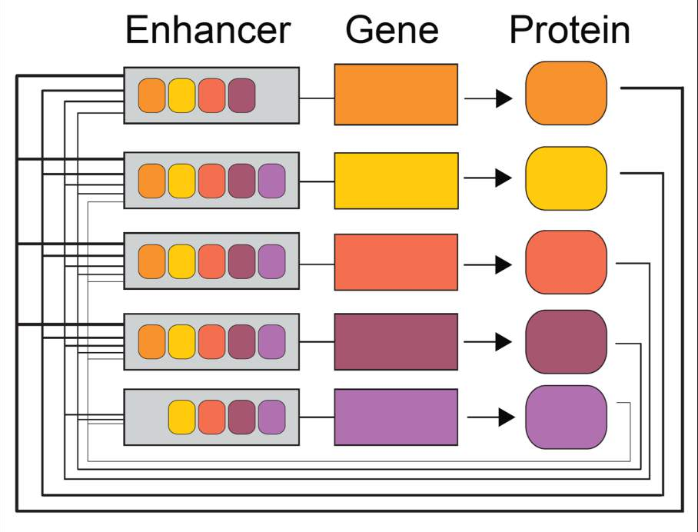



Core Regulatory Transcription Factors are:
Logical Circuits
Essential in cancer
Druggable
=
Cancer
1957, Conrad Waddington
8

Slide 9
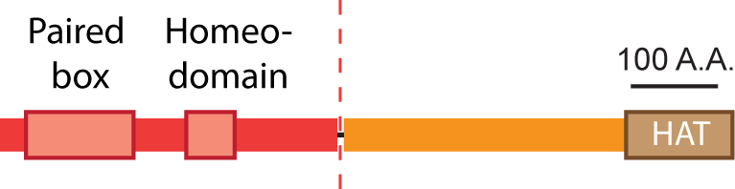
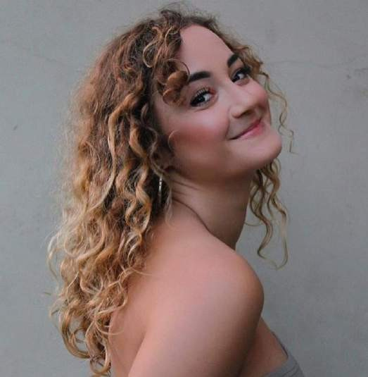
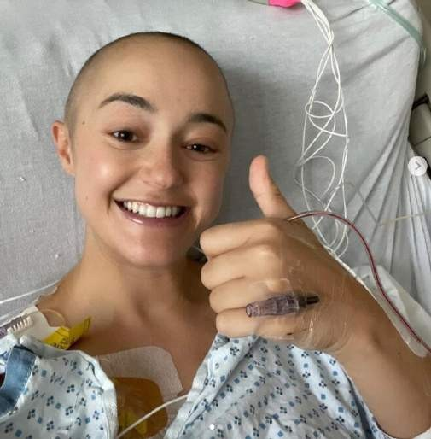
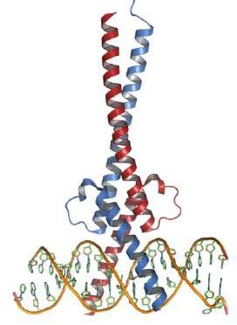
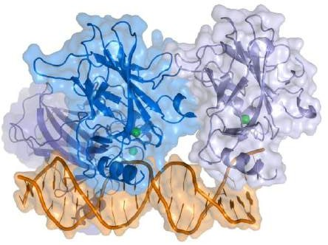
Kasey Altman
PAX3-FOXO1
Rare translocation
www.instagram.com/kasey.altman
p53
mutation
MYCN
amplification

Slide 10
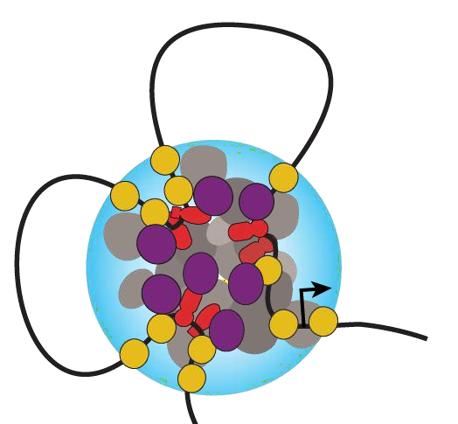

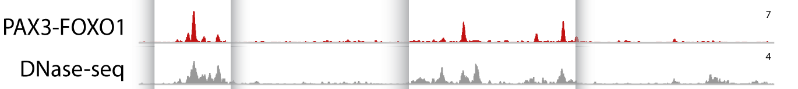
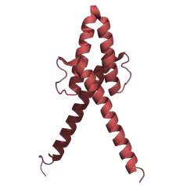
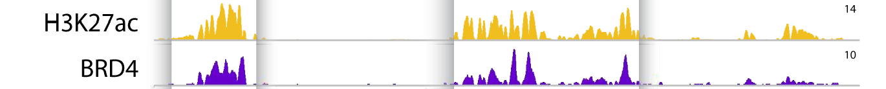
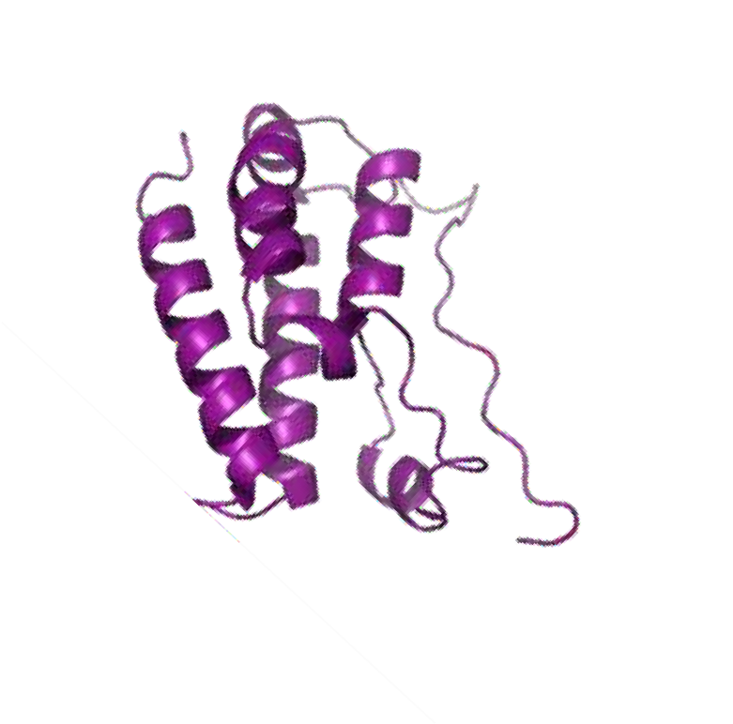

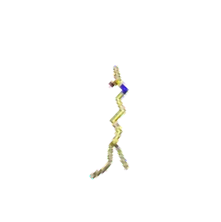
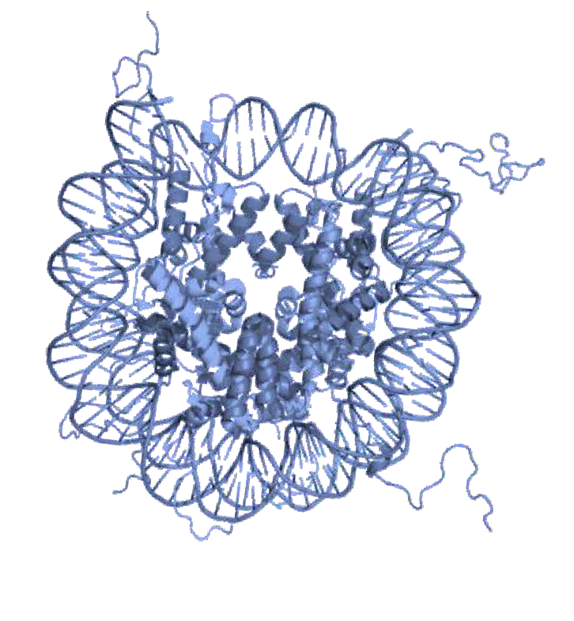
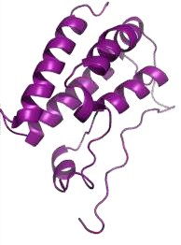

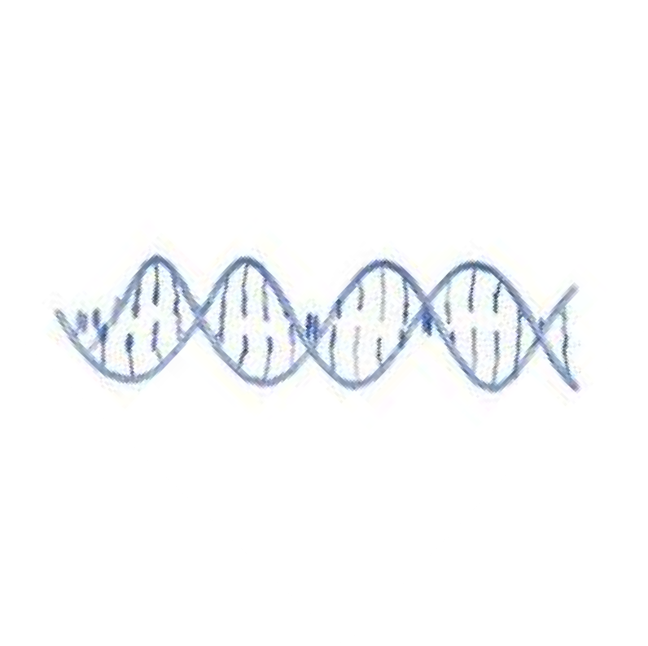
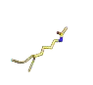
Core Reg. TFs build Super Enhancers
Super Enhancers
Oncogenes
Transcription
Factor
Enhancer
Enhancer
Gene
Enhancer
2017, Gryder, et al. Cancer Discovery
2019, Gryder, et al, Nature Genetics
2019, Gryder, et al, Nature Communications
2020, Gryder, et al, Nature Protocols
2021, Gryder, et al, iScience
2021, Laubscher, Gryder, Nature Comm.
10

Slide 11
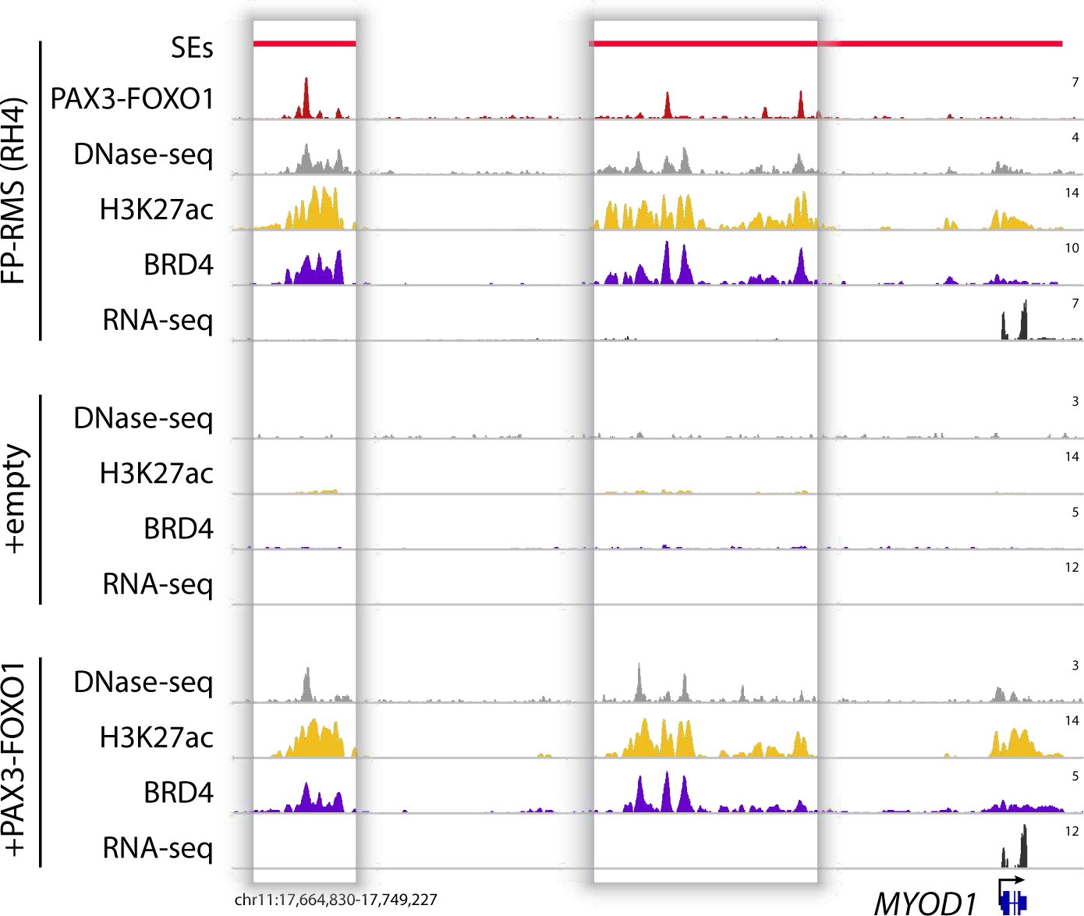
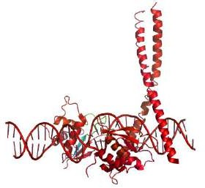
Where PAX3-FOXO1 goes, Acetylation follows
Cancer cells
Fibroblasts
2017, Cancer Discovery, Gryder, Yohe et al.
11

Slide 12
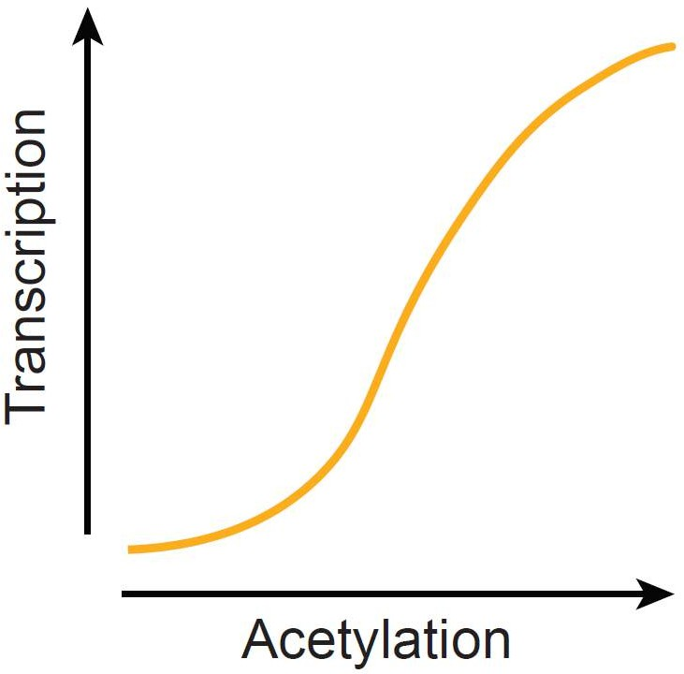
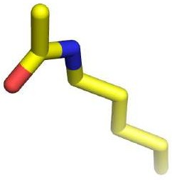
Transcription Factors PAX3-FOXO1 MYOD1
MYOG MYCN SOX8
Super Clusters
PAX3-FOXO1
Oncogenes FGFR4 IGF2
ALK
12

Slide 13
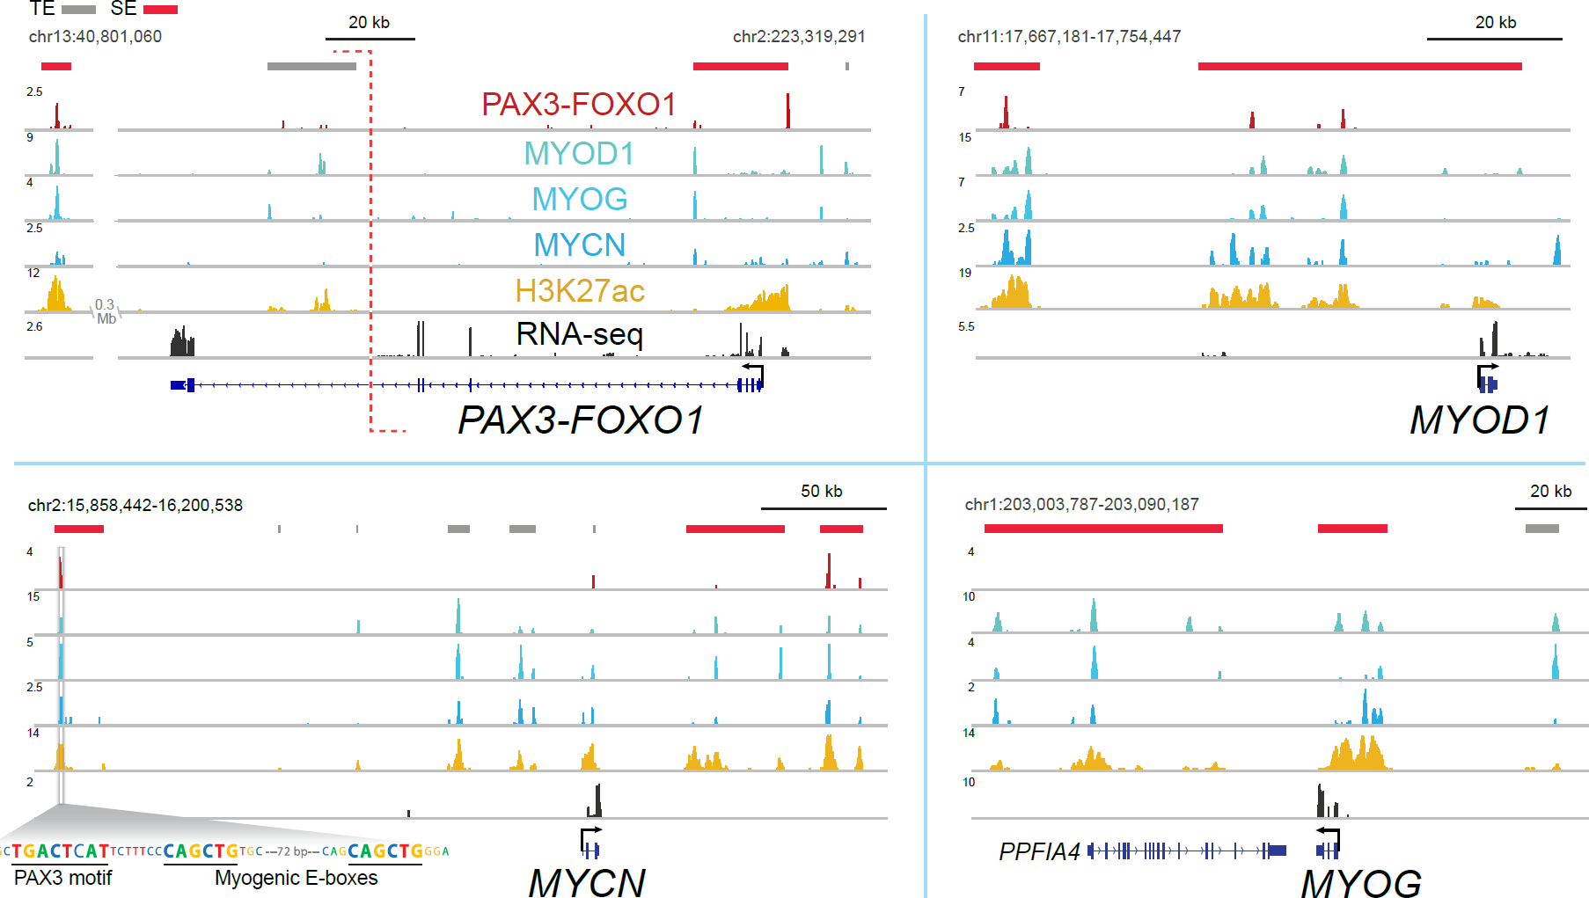
Core Regulatory TFs Bind Each others SEs
2017, Cancer Discovery, Gryder et al.
13

Slide 14
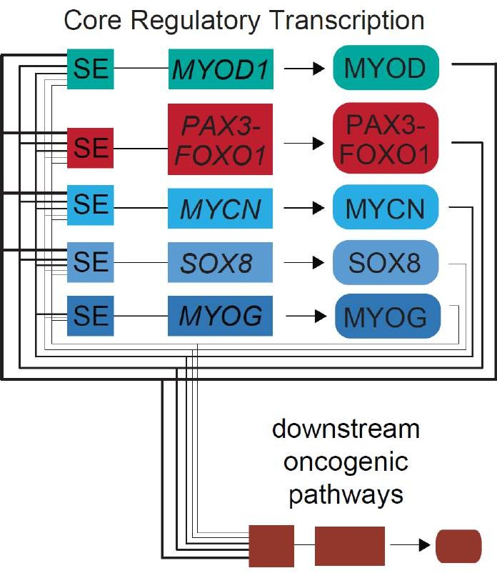
Core Regulatory TF Networks
Gryder et al., Nature Genetics

Slide 15
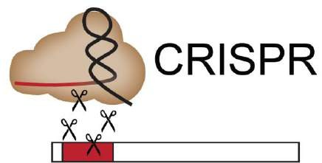
















1. Are Core Regulatory TFs essential for cancer growth?
2. Are they functionally redundant?
with Chris R. Vakoc (CSHL)
15

Slide 16


1. Are Core Regulatory TFs essential for cancer growth? YES
2. Are they functionally redundant? NO
2019 Gryder et al, Nature Genetics
with X. Sky Wu and Chris Vakoc (CSHL)
16

Slide 17


Therapeutic Window
DepMap 20Q1
17

Slide 18


How do we drug core regulatory TFs?

Slide 19


BRD2/3/4
HDAC1/2/3
SMARCA4
CBP/p300

Slide 20



16 top PAX3-FOXO1
bound Super Enhancers

Slide 21








&

Slide 22



Drugging CR TF transcription
Epi-machines
Core Regulatory TFs
2019, Nature Comm., Gryder et al

Slide 23
Transcription of CR TFs
could nascent transcription reveal different CR TF transcription kinetics?
2018, Nature Genetics, Chu et al

Slide 24


2019, bioRxiv, Blumberg et al.
nascent RNA (ChRO-seq)
steady state (RNA-seq)
mRNA decay

Slide 25
Theory: Super enhancers are required for core regulatory TFs because
CR TFs are encoded by unstable mRNA transcripts, requiring unusually high levels of continuous transcription
SEs are difficult to turn on, ensuring lineage restriction

Slide 26



HAT
HDAC

Slide 27

CR TF co-bind with HDACs
2019, Nature Comm., Gryder et al

Slide 28

CR TF co-bind with HDACs

Slide 29

More HDAC ∝ more transcription
2019, Nature Genetics, Gryder et al

Slide 30

?
30

Slide 31


Spike in ChIP-seq: ChIP-Rx
2014, Cell Reports, Orlando et al
2019, Nature Genetics, Gryder et al
31

Slide 32








How can we measure genome architecture?
32

Slide 33



How can we measure genome architecture?

Slide 34



ChIP-seq
HiC
HiChIP
+
=
2009, Nature, Fullwood ... Ruan: ChIA-PET 2016, Nat Meth, Mumbach ... Greenleaf, Chang: HiChIP
2016, Cell Res, Fang ... Ren: PLAC-seq
34

Slide 35


35

Slide 36

How can we see global changes in architecture?
2020, Gryder, Khan & Stanton, Nature Protocols
36

Slide 37



When to use AQuA?
global changes in
ChIP-target protein abundance
global changes in
chromatin compaction
2017, Cell, Weintraub ... Young
2017, Molecular Cell, Kieffer-Kwon ... Casellas
2019, Nature Genetics, Gryder ... Khan
37

Slide 38








H3K27ac
2020, Gryder, Khan & Stanton, Nature Protocols
38

Slide 39


Slide 40

AQuA normalization strategy

Slide 41


AQuA normalization strategy
H3K27ac
(all experiments RH4 cells +/- Entinostat, 6 hours)
41

Slide 42


AQuA normalization strategy
AQuA
HiC
AQuA
HiChIP
ChIP-Rx
1.43x
AQuA
impact
1.44x
Rx impact
2.76x
AQuA
impact
(all experiments RH4 cells +/- Entinostat, 6 hours)
42

Slide 43

Super Enhancers must Mind the Gap
2019, Gryder et al., Nature Genetics
43

Slide 44


HiChIP (H3K27ac)
AQuA
HiChIP (H3K27ac)

Slide 45
Can hyper-acetylating the boundaries of 1 super cluster phenocopy the effects of small molecule HDAC inhibition?

Slide 46


Recruitment of HAT by dCas9-FKPB
2019, Nature Biotechnology
with Nate Hathaway and Anna Chiarella

Slide 47

Recruitment of HAT by dCas9-FKPB
2019, Gryder et al., Nature Genetics

Slide 48




HDACi disrupts Pol2 but not BRD4 puncta
DMSO HDACi
ChIP-Rx
Pol2
DMSO
HDACi
ChIP-Rx
BRD4
2019, Gryder et al., Nature Genetics
48

Slide 49

HDACi removes Pol2 at SEs

Slide 50

Histone Acetylation Paradox Explained by Dynamic Opposition
~1000-3000 histone lysine + charges lost per CR TF loci
50

Slide 51
HDACs
& H3K27ac
KDM5A
& H3K4me3
HATs
& RNA Pol 2
New mechanism to explain HDAC inhibition
New mechanism to explain KDM5A inhibition
Pol2 cluster collapse
Nature Comm., 2019
Nature Genetics, 2019
Blood Cancer
Discovery, 2021
Unpublished

Slide 52



Lysine Demethylase 5A is Required for MYC-Driven Transcription
in Multiple Myeloma
Blood Cancer Discovery, 2021
Hiroto
Ohguchi
Jun Qi
Rotary Evaporator

Slide 53

KDM5A erases H3K4me3
ACS Chemical Biology, invited review

Slide 54



Designing our way through cell membranes, counting on metabolism
Blood Cancer Discovery, 2021

Slide 55




KDM5A inhibition
Blood Cancer Discovery, 2021

Slide 56


Lysine demethylase selectivity
Histone selectivity
Blood Cancer Discovery, 2021

Slide 57







Slide 58

KDM5A co-binds with CDK7/9 and MYC at H4K4me3 rich promoters
Blood Cancer Discovery, 2021

Slide 59


Slide 60




Resolving the H3K4me3 conundrum
Blood Cancer Discovery, 2021

Slide 61

Rescue attempt: distinguish direct v. indirect KDM5A effect
Blood Cancer Discovery, 2021

Slide 62




Dynamic Opposition of Histone Marks
2022, ACS Chem. Biol., Garzón-Porras, Chory & Gryder. Dynamic Opposition of Histone Modifications

Slide 63
HDACs
& H3K27ac
KDM5A
& H3K4me3
HATs
& RNA Pol 2
New mechanism to explain HDAC inhibition
New mechanism to explain KDM5A inhibition
Pol2 cluster collapse
Nature Comm., 2019
Nature Genetics, 2019
Blood Cancer
Discovery, 2021
Unpublished

Slide 64



Drugging Super Cluster Driven Transcription

Slide 65


unpublished

Slide 66


New chemical tool to study H3K27ac loop removal in short time frames
2021, Cell Chemical Biology, Vannam et al, Ott lab
unpublished

Slide 67



Core Regulatory TF Network requires CBP/p300
Core regulatory TFs
P3F dependent genes

Slide 68


dCBP1 rapidly secludes Pol2 away from P3F enhancers, and into CpG islands

Slide 69
Why would Pol2 move to CpG islands after HAT inhibition?

Slide 70



CpG islands promote open “landing pads” for Pol2 transcription
H3K27ac
Pol2 CpG islands
CpG rich sequences cannot
wrap around histones
Methylated CpG rich sequences
can wrap around histones
They are always open for Pol2 binding
DNA methylation causes gene silencing

Slide 71

Pol2 HiChIP loops
Pol2 HiChIP contact matrix

Slide 72

Tools to classify loops and clusters: github.com/GryderLab/peaks3d

Slide 73



PAX3-FOXO1 occupies the strongest Pol2 clusters

Slide 74



Slide 75





Pol2 soaked in CpG islands
Pol2 eviction
Collapse
Bloating

Slide 76


















Care. Collaborate. Create.
Collaborator labs:
Special thanks to: Ben Stanton Javed Khan Marielle Yohe
gryderlab.com
Jun Qi

